Slide 1
Consumer Goods AD-HOC insights
Angel Arturo Castellanos S

Slide 2
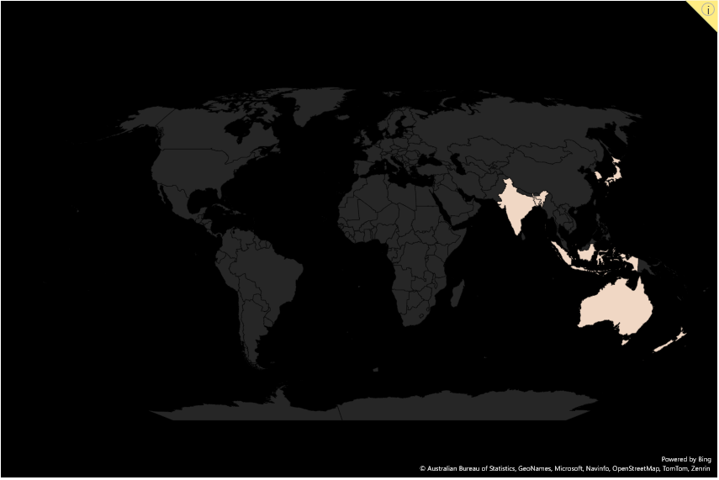
Altiq costumer – apac region
Australia
Bangladesh
India
Indonesia
Japan
New Zealand
Philippines
South Korea

Slide 3
Increase unique products 2020 - 2021
An increase of 36.33%

Slide 4
Review unique products by segment
This represents 80% of the total

Slide 5
Increment by segment per fiscal year

Slide 6


Range manufacturing products cost
AQ Home Allin1 Gen 2 $240,54
AQ Master Wired x1 Ms $0,892

Slide 7
Top 5 Customer with high % pre invoice Discount in Indian market

Slide 8
Altiq exclusive month by month analysis
COVID 19 Hard Lockdown

Slide 9
Comparison Quarter sold quantity in fiscal year 2020
*In Millions

Slide 10
Channel distribution in fiscal year 2021

Slide 11
Ranking Top 3 Products per division

